Slide 1

SQL Statement Fundamentals

Slide 2
SQL
This section focuses on basic SQL syntax that you will end up using in almost all your future queries.
The syntax shown in this section is applicable to any major SQL engine (e.g. MS SQL Server, MySQL, Oracle, etc…)

Slide 3
SQL
In general we will focus on the syntax for constructing a SQL query
Query : A request for information from the database.
After every major concept, we will have a challenge task for you to complete.
Let’s get started!

Slide 4
SELECT

Slide 5
SQL
SELECT is the most common statement used, and it allows us to retrieve information from a table.
Later on we will learn how to combine SELECT with other statements to perform more complex queries.

Slide 6
SQL
Example syntax for SELECT statement:
SELECT column_name FROM table_name

Slide 7
SQL
SELECT column_name FROM table_name

Slide 8
SQL
SELECT column_name FROM table_name
Database

Slide 9
SQL
SELECT column_name FROM table_name
Database
Table 1
Table 2
Table 3

Slide 10
SQL
SELECT column_name FROM table_name
Database
Table 1
Table 2
Table 3
c1 | c2 | c3
x | 23 | a
y | 18 | b
z | 46 | c
c1 | c2 | c3
1 | Q | 13
2 | R | 34
3 | S | 56
c1 | c2 | c3
c | 0 | 12
b | 0 | 24
b | 1 | 45

Slide 11
SQL
SELECT column_name FROM table_name
Database
Table 1
Table 2
Table 3
c1 | c2 | c3
x | 23 | a
y | 18 | b
z | 46 | c
c1 | c2 | c3
1 | Q | 13
2 | R | 34
3 | S | 56
c1 | c2 | c3
c | 0 | 12
b | 0 | 24
b | 1 | 45

Slide 12
SQL
SELECT column_name FROM table_name
Database
Table 1
Table 2
Table 3
c1 | c2 | c3
x | 23 | a
y | 18 | b
z | 46 | c
c1 | c2 | c3
1 | Q | 13
2 | R | 34
3 | S | 56
c1 | c2 | c3
c | 0 | 12
b | 0 | 24
b | 1 | 45

Slide 13
SQL
SELECT c1 FROM table_1
Database
Table 1
Table 2
Table 3
c1 | c2 | c3
x | 23 | a
y | 18 | b
z | 46 | c
c1 | c2 | c3
1 | Q | 13
2 | R | 34
3 | S | 56
c1 | c2 | c3
c | 0 | 12
b | 0 | 24
b | 1 | 45

Slide 14
SQL
SELECT c1, c2 FROM table_1
Database
Table 1
Table 2
Table 3
c1 | c2 | c3
x | 23 | a
y | 18 | b
z | 46 | c
c1 | c2 | c3
1 | Q | 13
2 | R | 34
3 | S | 56
c1 | c2 | c3
c | 0 | 12
b | 0 | 24
b | 1 | 45

Slide 15
SQL
SELECT c1, c3 FROM table_1
Database
Table 1
Table 2
Table 3
c1 | c2 | c3
x | 23 | a
y | 18 | b
z | 46 | c
c1 | c2 | c3
1 | Q | 13
2 | R | 34
3 | S | 56
c1 | c2 | c3
c | 0 | 12
b | 0 | 24
b | 1 | 45

Slide 16
SQL
SELECT * FROM table_1
Database
Table 1
Table 2
Table 3
c1 | c2 | c3
x | 23 | a
y | 18 | b
z | 46 | c
c1 | c2 | c3
1 | Q | 13
2 | R | 34
3 | S | 56
c1 | c2 | c3
c | 0 | 12
b | 0 | 24
b | 1 | 45

Slide 17
SQL
In general it is not good practice to use an asterisk (*) in the SELECT statement if you don’t really need all columns.
It will automatically query everything, which increases traffic between the database server and the application, which can slow down the retrieval of results.

Slide 18
SQL
If you only need certain columns, do your best to only query for those columns.
Let’s walk through some examples in our dvdrental database to get some practice!

Slide 19
SELECT
CHALLENGE TASKS

Slide 20
SQL
Challenge Structures
Business Situation
Challenge Question
Expected Answer
Hints
Solution

Slide 21
SQL
Challenge Structures
Business Situation
Challenge Question
Expected Answer
Hints
Solution

Slide 22
SQL
Situation
We want to send out a promotional email to our existing customers!

Slide 23
SQL
Situation
We want to send out a promotional email to our existing customers!

Slide 24
SQL
Challenge
Use a SELECT statement to grab the first and last names of every customer and their email address.

Slide 25
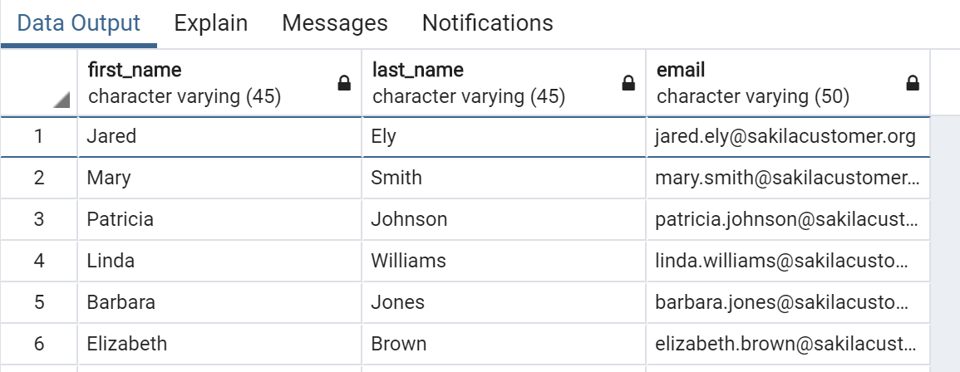
SQL
Expected Answer: (may not be displayed in the exact same order)

Slide 26
SQL
Hints
Use the customer table
You can use the table drop-down to view what columns are available
You could also use SELECT * FROM customer to see all the columns.

Slide 27
SQL
Solution
Let’s check it out in pgadmin!

Slide 28
SELECT DISTINCT

Slide 29
SQL
Sometimes a table contains a column that has duplicate values, and you may find yourself in a situation where you only want to list the unique/distinct values.
The DISTINCT keyword can be used to return only the distinct values in a column.

Slide 30
SQL
The DISTINCT keyword operates on a column. The syntax looks like this:
SELECT DISTINCT column FROM table

Slide 31
SQL
To clarify which column DISTINCT is being applied to, you can also use parenthesis for clarity:
SELECT DISTINCT(column) FROM table

Slide 32
SQL
It will work with or without parenthesis.
Later on when we learn about adding more calls such as COUNT and DISTINCT together, the parenthesis will be necessary.
SELECT DISTINCT column FROM table

Slide 33
SQL
What does it actually mean to call DISTINCT on a column?
Name | Choice
Zach | Green
David | Green
Claire | Yellow
David | Red

Slide 34
SQL
Imagine a table of people who were surveyed to choose a color:
Name | Choice
Zach | Green
David | Green
Claire | Yellow
David | Red

Slide 35
SQL
SELECT DISTINCT name FROM color_table
Name | Choice
Zach | Green
David | Green
Claire | Yellow
David | Red

Slide 36
SQL
SELECT DISTINCT name FROM color_table
Name
Zach
David
Claire

Slide 37
SQL
Given the previous example, we don’t really know if the person with the name “David” was a duplicate entry, or two different people with the same first name.
Calling DISTINCT here answered the question
What are the unique first names are there in the table?

Slide 38
SQL
It makes more sense to ask “How many types of unique color choices were there?”
Name | Choice
Zach | Green
David | Green
Claire | Yellow
David | Red

Slide 39
SQL
SELECT DISTINCT choice
FROM color_table
Choice
Green
Yellow
Red

Slide 40
SQL
Let’s see a use case of when DISTINCT would be useful.

Slide 41
SELECT DISTINCT
CHALLENGE

Slide 42
SQL
Situation
SQL Challenge
Expected Results
Hints
Solution

Slide 43
SQL
Situation
An Australian visitor isn’t familiar with MPAA movie ratings (e.g. PG , PG-13, R, etc…)
We want to know the types of ratings we have in our database.
What ratings do we have available?

Slide 44
SQL
SQL Challenge
Use what you’ve learned about SELECT DISTINCT to retrieve the distinct rating types our films could have in our database.

Slide 45
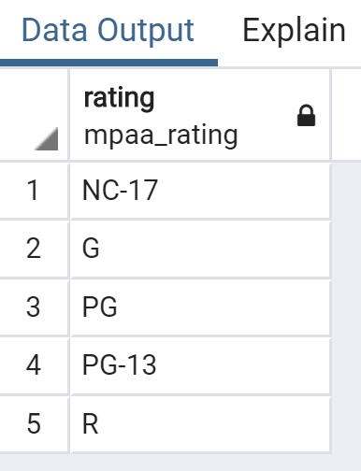
SQL
Expected Result

Slide 46
SQL
Hints
Use the film table
Use SELECT * FROM film; to see what columns are available.
Or use drop down table menu in pgadmin.

Slide 47
SQL
Solution
SELECT DISTINCT rating FROM film;

Slide 48
COUNT

Slide 49
SQL
The COUNT function returns the number of input rows that match a specific condition of a query.
We can apply COUNT on a specific column or just pass COUNT(*) , we will soon see this should return the same result.

Slide 50
SQL
Let’s see a simple example
Name | Choice
Zach | Green
David | Green
Claire | Yellow
David | Red

Slide 51
SQL
SELECT COUNT(name) FROM table;
Name | Choice
Zach | Green
David | Green
Claire | Yellow
David | Red

Slide 52
SQL
SELECT COUNT(name) FROM table;
Count
4

Slide 53
SQL
SELECT COUNT(name) FROM table;
This is simply returning the number of rows in the table.
In fact, it should be the same regardless of the column.
Count
4

Slide 54
SQL
Each column has the same number of rows
Name | Choice
Zach | Green
David | Green
Claire | Yellow
David | Red

Slide 55
SQL
SELECT COUNT(name) FROM table;
SELECT COUNT(choice) FROM table;
SELECT COUNT(*) FROM table;
All return the same thing, since the original table had 4 rows.
Count
4

Slide 56
SQL
Because of this COUNT by itself simply returns back a count of the number of rows in a table.
COUNT is much more useful when combined with other commands, such as DISTINCT

Slide 57
SQL
Imagine we wanted to know: How many unique names are there in the table?
Name | Choice
Zach | Green
David | Green
Claire | Yellow
David | Red

Slide 58
SQL
SELECT COUNT(DISTINCT name)
FROM table;
Name | Choice
Zach | Green
David | Green
Claire | Yellow
David | Red

Slide 59
SQL
SELECT COUNT(DISTINCT name)
FROM table;
Name | Choice
Zach | Green
David | Green
Claire | Yellow
David | Red

Slide 60
SQL
SELECT COUNT(DISTINCT name)
FROM table;
Name | Choice
Zach | Green
David | Green
Claire | Yellow

Slide 61
SQL
SELECT COUNT(DISTINCT name)
FROM table;
Count
3

Slide 62
SQL
SELECT COUNT(DISTINCT name)
FROM table;
Count
3

Slide 63
SQL
SELECT COUNT(DISTINCT(name))
FROM table;
Count
3

Slide 64
SQL
Let’s explore some examples in pgAdmin!

Slide 65
SELECT WHERE
PART ONE

Slide 66
SQL
SELECT and WHERE are the most fundamental SQL statements and you will find yourself using them often!
The WHERE statement allows us to specify conditions on columns for the rows to be returned.

Slide 67
SQL
Basic syntax example:
SELECT column1, column2
FROM table
WHERE conditions;

Slide 68
SQL
The WHERE clause appears immediately after the FROM clause of the SELECT statement.
The conditions are used to filter the rows returned from the SELECT statement.
PostgreSQL provides a variety of standard operators to construct the conditions

Slide 69
SQL
Comparison Operators
Compare a column value to something.
Is the price greater than $3.00?
Is the pet’s name equal to “Sam”?

Slide 70
SQL
Comparison Operators
Operator | Description
= | Equal
> | Greater than
< | Less Than
>= | Greater than or equal to
<= | Less than or equal to
<> or != | Not equal to

Slide 71
SQL
Logical Operators
Allow us to combine multiple comparison operators
AND
OR
NOT

Slide 72
SQL
Simple Syntax Example
Name | Choice
Zach | Green
David | Green
Claire | Yellow
David | Red

Slide 73
SQL
SELECT name,choice FROM table
Name | Choice
Zach | Green
David | Green
Claire | Yellow
David | Red

Slide 74
SQL
SELECT name,choice FROM table
Now let’s get only the people named David
Name | Choice
Zach | Green
David | Green
Claire | Yellow
David | Red

Slide 75
SQL
SELECT name,choice FROM table
WHERE name = ‘David’
Name | Choice
David | Green
David | Red

Slide 76
SQL
SELECT name FROM table
WHERE name = ‘David’
Name
David
David

Slide 77
SQL
SELECT name,choice FROM table
WHERE name = ‘David’
Name | Choice
David | Green
David | Red

Slide 78
SQL
SELECT name,choice FROM table
WHERE name = ‘David’ AND choice= ‘Red’
Name | Choice
David | Red

Slide 79
SELECT WHERE
PART TWO
Code Along Examples

Slide 80
SELECT WHERE
Challenge Task

Slide 81
SQL
We now know enough to answer more realistic business questions and tasks instead of directly asking for specific SQL tasks.
From now on we will focus more on directly asking the business related questions, to more realistically model a typical task.

Slide 82
SQL
For example:
How many customers have the first name Jared?
Instead of:
Use SELECT WHERE to find “Jared” in the first_name column in the customer table.

Slide 83
SQL
One last thing to keep in mind is that as we continue to learn more about SQL, you will soon realize there are usually many different ways to arrive at the same solution
Verify your work mainly against the expected result instead of our SQL solution

Slide 84
SQL
Business Situation/Question
Expected Result
Hints
Solution

Slide 85
SQL
Challenge No. 1
A customer forgot their wallet at our store! We need to track down their email to inform them.
What is the email for the customer with the name Nancy Thomas?

Slide 86
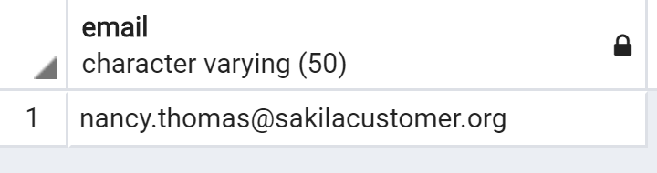
SQL
Expected Answer for Challenge No. 1

Slide 87
SQL
Hints for Challenge No. 1
Use the customer table
Make sure the capitalization and spelling of the names is correct
Use AND to combine conditions
Use single quotes around the ‘string’

Slide 88
SQL
Solution for Challenge No. 1
SELECT email FROM customer
WHERE first_name = ‘Nancy’
AND last_name = ‘Thomas’;

Slide 89
SQL
Challenge No. 2
A customer wants to know what the movie “Outlaw Hanky” is about.
Could you give them the description for the movie “Outlaw Hanky”?

Slide 90
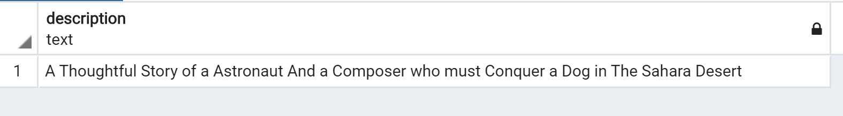
SQL
Expected Answer for Challenge No. 2

Slide 91
SQL
Hints for Challenge No. 2
Use the film table
Make sure the capitalization and spelling of the movie name is correct
Use single quotes around the ‘string’

Slide 92
SQL
Solution for Challenge No. 2
SELECT description FROM film
WHERE title = ‘Outlaw Hanky’;

Slide 93
SQL
Challenge No. 3
A customer is late on their movie return, and we’ve mailed them a letter to their address at ‘259 Ipoh Drive’. We should also call them on the phone to let them know.
Can you get the phone number for the customer who lives at ‘259 Ipoh Drive’?

Slide 94
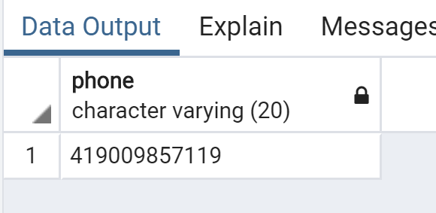
SQL
Expected Answer for Challenge No. 3

Slide 95
SQL
Hints for Challenge No. 3
Use the address table
Make sure the capitalization and spelling of the address is correct
Use single quotes around the ‘string’

Slide 96
SQL
Solution for Challenge No. 3
SELECT phone FROM address
WHERE address= ‘259 Ipoh Drive’;

Slide 97
ORDER BY

Slide 98
SQL
You may have noticed PostgreSQL sometimes returns the same request query results in a different order.
You can use ORDER BY to sort rows based on a column value, in either ascending or descending order.

Slide 99
SQL
Basic syntax for ORDER BY
SELECT column_1,column_2
FROM table
ORDER BY column_1 ASC / DESC

Slide 100
SQL
Notice ORDER BY towards the end of a query, since we want to do any selection and filtering first, before finally sorting.
SELECT column_1,column_2
FROM table
ORDER BY column_1 ASC / DESC

Slide 101
SQL
Use ASC to sort in ascending order
Use DESC to sort in descending order
If you leave it blank, ORDER BY uses ASC by default.

Slide 102
SQL
You can also ORDER BY multiple columns
This makes sense when one column has duplicate entries.
Company | Name | Sales
Apple | Andrew | 100
Google | David | 500
Apple | Zach | 300
Google | Claire | 200
Xerox | Steven | 100

Slide 103
SQL
SELECT company,name,sales FROM table
ORDER BY company,sales
Company | Name | Sales
Apple | Andrew | 100
Apple | Zach | 300
Google | Claire | 200
Google | David | 500
Xerox | Steven | 100

Slide 104
SQL
Let’s explore some examples in pgAdmin!

Slide 105
LIMIT

Slide 106
SQL
The LIMIT command allows us to limit the number of rows returned for a query.
Useful for not wanting to return every single row in a table, but only view the top few rows to get an idea of the table layout.
LIMIT also becomes useful in combination with ORDER BY

Slide 107
SQL
LIMIT goes at the very end of a query request and is the last command to be executed.
Let’s learn the basic syntax of LIMIT through some examples.

Slide 108
ORDER BY
Challenge Tasks

Slide 109
SQL
Challenge Task / Business Situation
Expected Result
Hints
Solution

Slide 110
SQL
Challenge Task
We want to reward our first 10 paying customers.
What are the customer ids of the first 10 customers who created a payment?

Slide 111
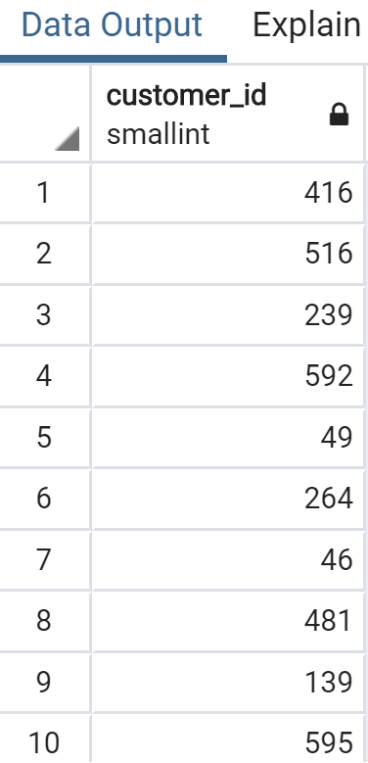
SQL
Expected Result

Slide 112
SQL
Hints
Use the payment table
You will need to use both ORDER BY and LIMIT
Remember you may need to specify ASC or DESC

Slide 113
SQL
Solution
SELECT customer_id FROM payment
ORDER BY payment_date ASC
LIMIT 10;

Slide 114
SQL
Challenge Task
A customer wants to quickly rent a video to watch over their short lunch break.
What are the titles of the 5 shortest (in length of runtime) movies?

Slide 115
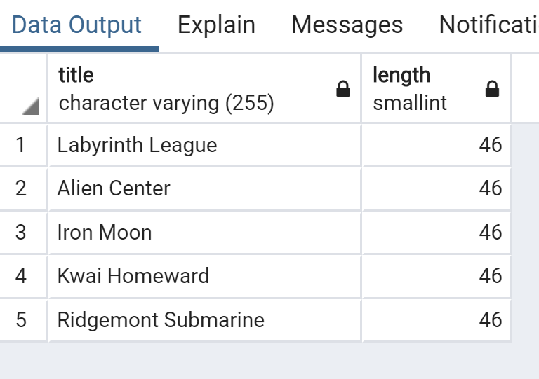
SQL
Expected Results

Slide 116
SQL
Hints
Use the film table
Take a look at the length column
You can use ORDER BY and LIMIT
Remember to use ASC or DESC to get desired results

Slide 117
SQL
Example Solution
SELECT title,length FROM film
ORDER BY length ASC
LIMIT 5;

Slide 118
SQL
Quick Bonus Question
If the previous customer can watch any movie that is 50 minutes or less in run time, how many options does she have?

Slide 119
SQL
Expected Result
37

Slide 120
SQL
SELECT COUNT(title) FROM film
WHERE length <= 50

Slide 121
BETWEEN

Slide 122
SQL
The BETWEEN operator can be used to match a value against a range of values:
value BETWEEN low AND high

Slide 123
SQL
The BETWEEN operator is the same as:
value >= low AND value <= high
value BETWEEN low AND high

Slide 124
SQL
You can also combine BETWEEN with the NOT logical operator:
value NOT BETWEEN low AND high

Slide 125
SQL
The NOT BETWEEN operator is the same as:
value < low OR value > high
value NOT BETWEEN low AND high

Slide 126
SQL
The BETWEEN operator can also be used with dates. Note that you need to format dates in the ISO 8601 standard format, which is YYYY-MM-DD
date BETWEEN ‘2007-01-01’
AND ‘2007-02-01’

Slide 127
SQL
When using BETWEEN operator with dates that also include timestamp information, pay careful attention to using BETWEEN versus <=,>= comparison operators, due to the fact that a datetime starts at 0:00.
Later on we will study more specific methods for datetime information types.

Slide 128
SQL
Let’s get some quick practice in pgAdmin!

Slide 129
IN

Slide 130
SQL
In certain cases you want to check for multiple possible value options, for example, if a user’s name shows up IN a list of known names.
We can use the IN operator to create a condition that checks to see if a value in included in a list of multiple options.

Slide 131
SQL
The general syntax is:
value IN (option1,option2,...,option_n)

Slide 132
SQL
Example query:
SELECT color FROM table
WHERE color IN (‘red’,’blue’)

Slide 133
SQL
Example query:
SELECT color FROM table
WHERE color IN (‘red’,’blue’,’green’)

Slide 134
SQL
Example query:
SELECT color FROM table
WHERE color NOT IN (‘red’,’blue’)

Slide 135
SQL
Let’s see some examples in pgAdmin!

Slide 136
LIKE and ILIKE
Using Pattern Matching

Slide 137
SQL
We’ve already been able to perform direct comparisons against strings, such as:
WHERE first_name= ‘John’
But what if we want to match against a general pattern in a string?
All emails ending in ‘@gmail.com’
All names that begin with an ‘A’

Slide 138
SQL
The LIKE operator allows us to perform pattern matching against string data with the use of wildcard characters:
Percent %
Matches any sequence of characters
Underscore _
Matches any single character

Slide 139
SQL
All names that begin with an ‘A’
WHERE name LIKE ‘A%’
All names that end with an ‘a’
WHERE name LIKE ‘%a’
Notice that LIKE is case-sensitive, we can use ILIKE which is case-insensitive

Slide 140
SQL
Using the underscore allows us to replace just a single character
Get all Mission Impossible films
WHERE title LIKE ‘Mission Impossible _’

Slide 141
SQL
You can use multiple underscores
Imagine we had version string codes in the format ‘Version#A4’ , ‘Version#B7’, etc...
WHERE value LIKE ‘Version#__’

Slide 142
SQL
We can also combine pattern matching operators to create more complex patterns
WHERE name LIKE ‘_her%’
Cheryl
Theresa
Sherri

Slide 143
SQL
We can also combine pattern matching operators to create more complex patterns
WHERE name LIKE ‘_her%’
Cheryl
Theresa
Sherri

Slide 144
SQL
Here we just focus on LIKE and ILIKE for now, but keep in mind PostgreSQL does support full regex capabilities:
https://www.postgresql.org/docs/12/functions-matching.html

Slide 145
SQL
Let’s check out some examples in PgAdmin!

Slide 146
SQL Statement Fundamentals
GENERAL CHALLENGE

Slide 147
SQL
Time to test your skills!
We’re going to set you up with a few situations and your task is to figure out the SQL query to solve them.
Note! You can also check out the supplemental resource link for this lecture to view these tasks in a simple document.

Slide 148
SQL
The online doc has the task and the expected result.
This video will have:
The Task
The Expected Result
Hints
The next video will work through the solutions.

Slide 149
SQL
Task No. 1

